Slide 1

Single Cell Data Wrangling With Scanpy
Michael Passalacqua

Slide 2
Lecture Goals
Understand RNAsequencing
Understand single cell data formatting and structure
Familiarize common tools used to process and explore single cell data
Grasp impact of dimensionality and sparseness on single cell data

Slide 3
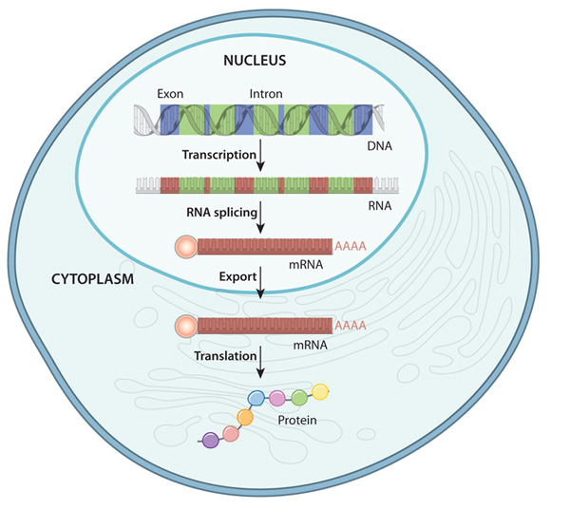
Gene expression is a key step on the path to cell types
mRNA is produced by the transcription of DNA, before being translated into protein
Protein defines the function of what a cell does, and through that, its cell type
Capturing protein is very difficult, so instead we capture RNA

Slide 4
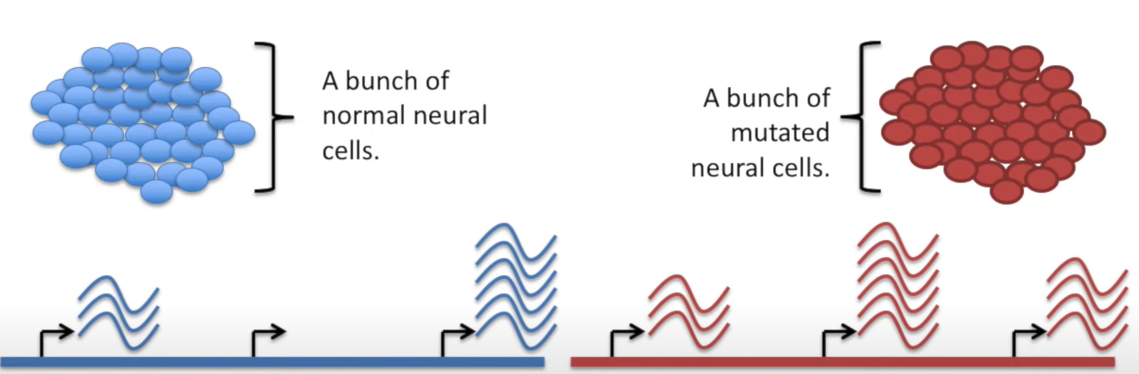
RNA sequencing provides counts of the number of RNA molecules in a sample
Sodium Channel Gene
Potassium Channel Gene
DNA repair Gene
Sodium Channel Gene
Potassium Channel Gene
DNA repair Gene

Slide 5
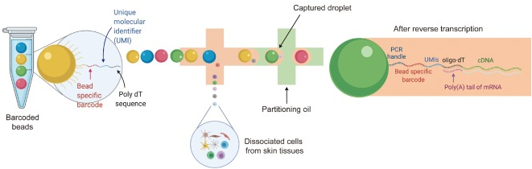
Single Cell RNA Sequencing

Slide 6


Single Cell RNA Sequencing – Avoiding the Smoothie
Bulk sequencing homogenizes sample- average of all cells in it
Lose multiple axes of information
Spatial
Temporal
Cell specific
Compositional
Droplet based SC-RNAseq can retrieve all of these but spatial

Slide 7
Single Cell RNA Sequencing – Negatives
Single cell can be technically difficult, especially for samples with thick cell walls or large amounts of starch/glycoproteins
Clustering can obscure extremely rare cell types
Sparsity can miss genes expressed at a low level
Results can be dominated by strong effects - like cell cycle
Important to have a clear goal that single cell accomplishes, if not bulk sequencing is often better

Slide 8
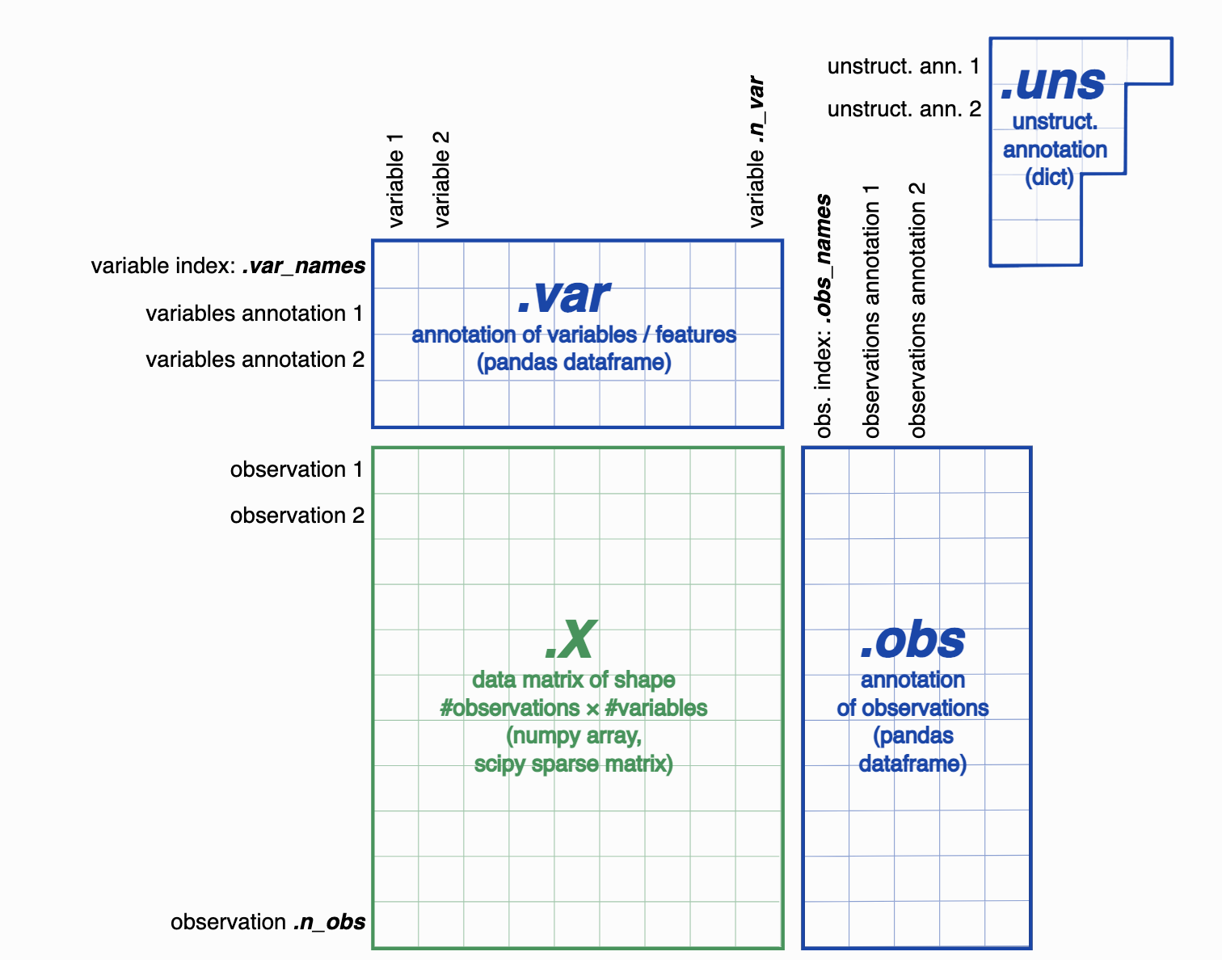
Single Cell Data Structure

Slide 9
Work Flow for Analyzing Single Cell Data
Read in and clean dataset
Important to speed up processing
QC check and visualize data
Checks data for major handling errors
Cluster and ID cell types
Group similar cells with other similar cells
Removes unused information that might clutter analysis
Removes technical artifacts
Gronk your data
Reduce data to human interpretably dimensionality
Enable downstream analysis

Slide 10
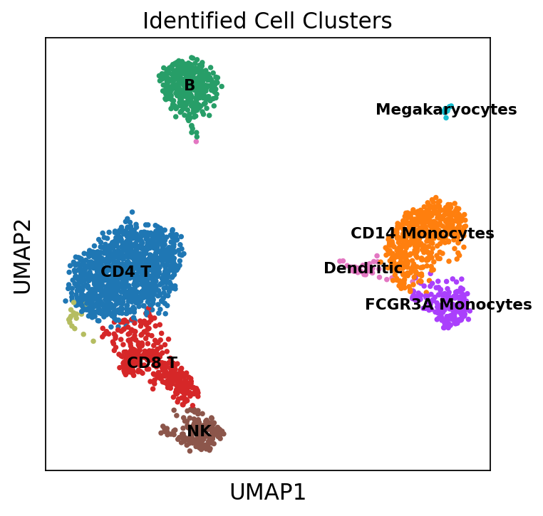

Slide 11
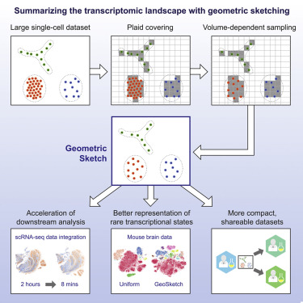
Sketching Single Cell Data
Single Cell Data is becoming larger and larger (Millions of cells)
Very challenging to read all of that into memory
Instead we summarize the data with representative samples to do analysis

Slide 12
Resources for learning more
https://distill.pub/2016/misread-tsne/
https://www.krishnaswamylab.org/workshop

